Slide 1
Will you allow this on your site?
Let’s beat up fat kids
I hope someone kills you
Someone shoot Trump
#stab and become the fear of the Zionist.
Content Moderation

Slide 2
Facebook’s internal rulebook for content moderation:
✅
Let’s beat up fat kids
✅
I hope someone kills you
❌
Someone shoot Trump
❌
#stab and become the fear of the Zionist.

Slide 3

Toward Fairness and Transparency in Content Moderation
Shagun Jhaver

Slide 4


Ph.D. Candidate in Computer Science,
Social Computing

Slide 5

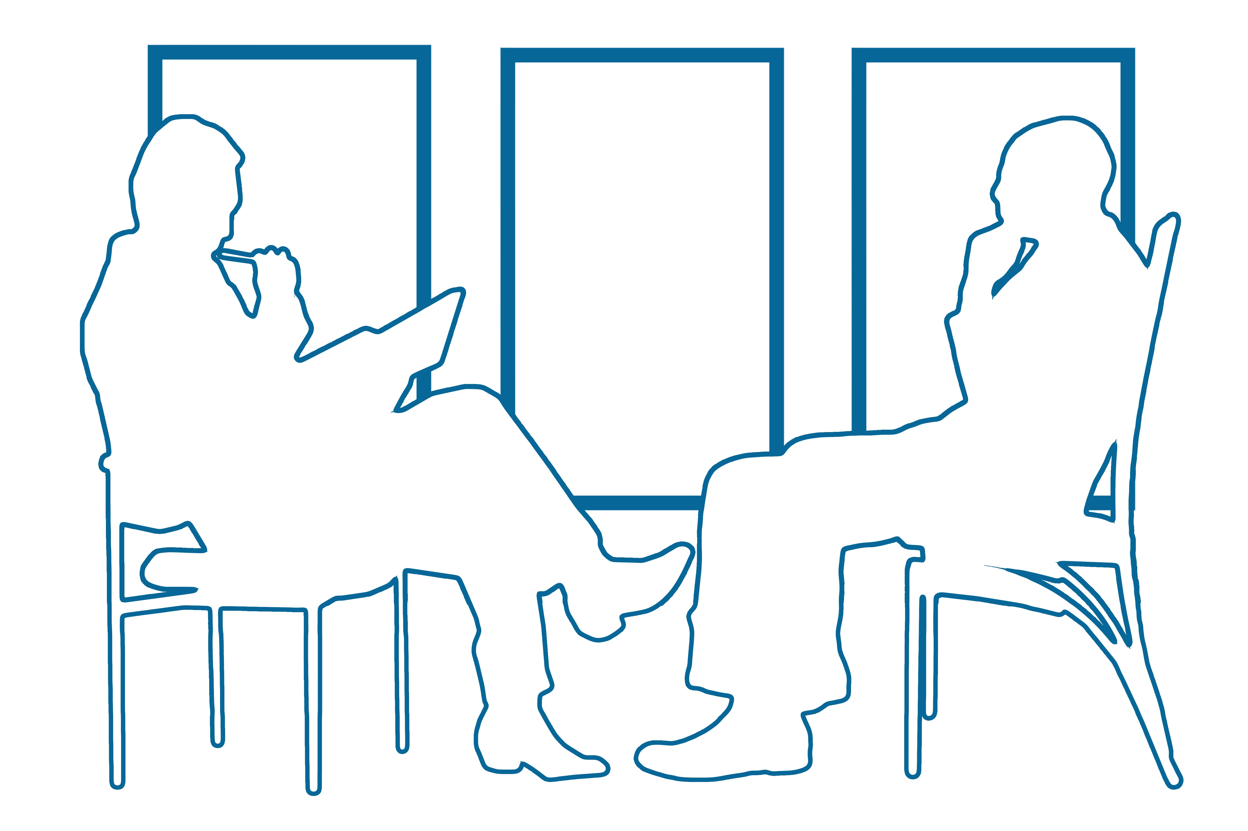


Mixed-Methods Researcher
Participant
Observation
Interviews
Surveys
Data Mining

Slide 6
Qualitative Studies
Shagun Jhaver, Sucheta Ghoshal, Amy Bruckman and Eric Gilbert. (2018). “Online Harassment and Content Moderation: The Case of Blocklists.” ACM TOCHI. Featured in Editor’s Spotlight
Shagun Jhaver, Iris Birman, Eric Gilbert, Amy Bruckman. (2019). “Human-Machine Collaboration for Content Regulation: The Case of Reddit Automoderator.” ACM TOCHI.
Shagun Jhaver, Yoni Karpfen and Judd Antin, “Algorithmic Anxiety and Coping Strategies of Airbnb Hosts,” CHI 2018.
Shagun Jhaver, Larry Chan, and Amy Bruckman. (2018). “The View from the Other Side: The Border Between Controversial Speech and Harassment on Kotaku in Action.” First Monday.
Shagun Jhaver, Pranil Vora, and Amy Bruckman. (2017). “Designing for Civil Conversations: Lessons Learned from ChangeMyView.” GVU Technical Report.

Slide 7

Build a foundation for designing
fair and efficient content moderation systems
©Francesco Ungaro
Notes:
The main goal of my research is to

Slide 8

Contributions: Transparency in content moderation
Study 1
Improvements in user attitudes
Transparency =>
attitudes
Study 2
behaviors
Improvements in
user behaviors
Transparency =>

Slide 9





Agenda
Research overview
Transparency in content moderation
Study 1: User attitudes
Study 2: User behaviors
Future work

Slide 10







Content moderation
Kotaku in Action
Automod
Blocklists
Fairness
Removal explanations
Future of work
Social signals
Skill searches
Airbnb algorithm
Learning
to Airbnb
Automod
PostScholar
Sharing economy
Platform interventions
FATE
Airbnb algorithm
Learning
to Airbnb
Deplatforming
Quarantining
Fairness
Social movements
Community norms
Black lives matter
Kotaku in Action
Men’s rights
Reddit norms
Change my view
Notes:
During my doctoral studies, I have lead or contributed to a variety of projects related to

Slide 11
Content moderation
Kotaku in Action
Automod
Blocklists
Fairness
Removal explanations
Future of work
Social signals
Skill searches
Airbnb algorithm
Learning
to Airbnb
Automod
PostScholar
Sharing economy
Platform interventions
FATE
Airbnb algorithm
Learning
to Airbnb
Deplatforming
Quarantining
Fairness
Social movements
Community norms
Black lives matter
Kotaku in Action
Men’s rights
Reddit norms
Change my view

Slide 12
Content moderation
Kotaku in Action
Automod
Blocklists
Fairness
Removal explanations
Future of work
Social signals
Skill searches
Airbnb algorithm
Learning
to Airbnb
Automod
PostScholar
Sharing economy
Platform interventions
FATE
Airbnb algorithm
Learning
to Airbnb
Deplatforming
Quarantining
Fairness
Social movements
Community norms
Black lives matter
Kotaku in Action
Men’s rights
Reddit norms
Change my view

Slide 13
What is Content Moderation?

Slide 14
What is content moderation?
“Governance mechanisms that structure participation in a community to facilitate cooperation and prevent abuse” (Grimmelmann 2015)
Determines for each post:
Whether it will be allowed or removed
Grimmelmann, James (2015) The Virtues of Moderation, Yale Journal of Law and Technology, Vol. 17, Issue 1

Slide 15

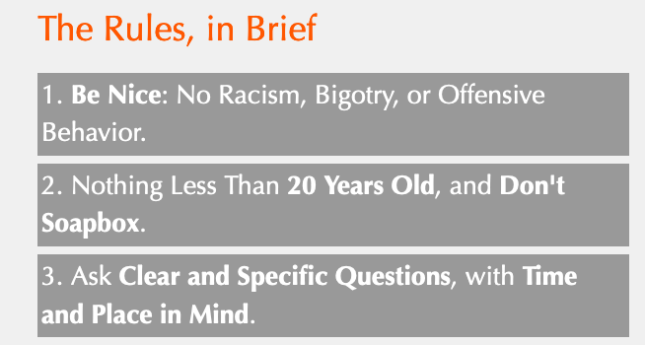



A complex sociotechnical system
Admins
Rules
Moderators
Mod bots
End users

Slide 16
Why is Content Moderation Important?

Slide 17
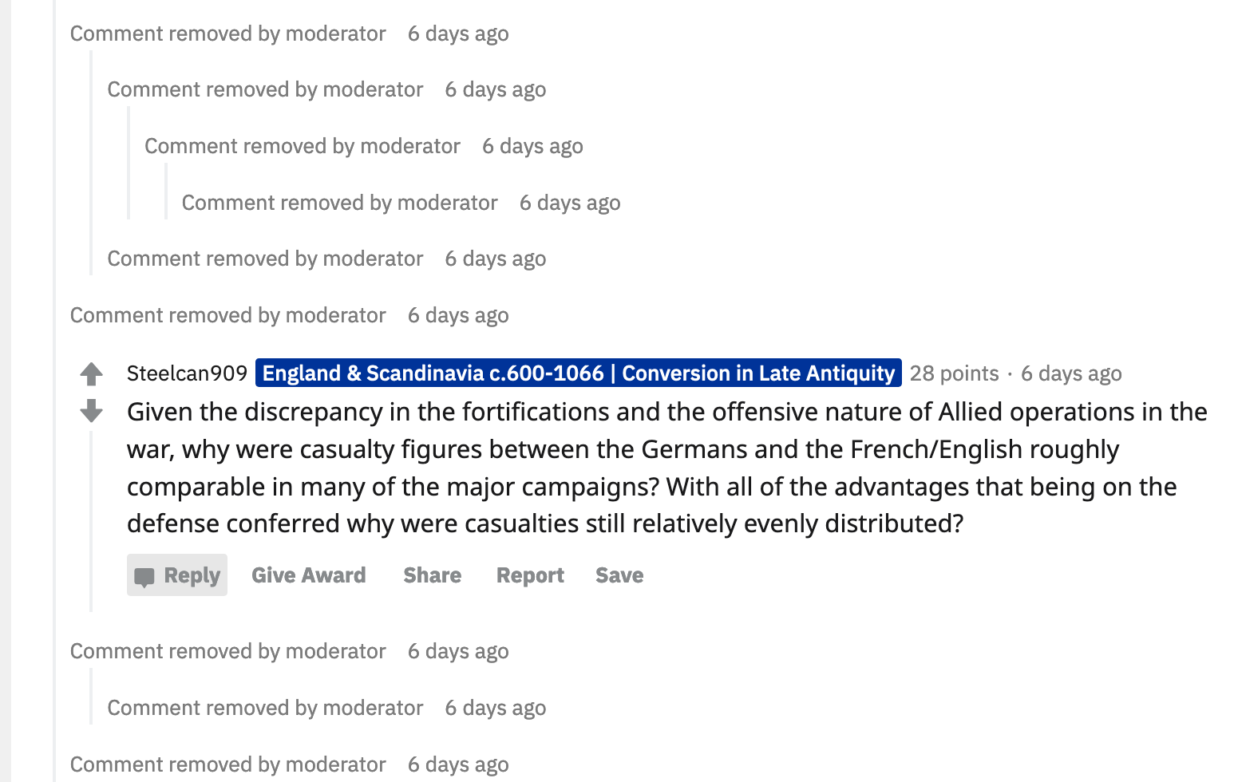
It helps users find relevant information

Slide 18
It helps users find relevant information

Slide 19
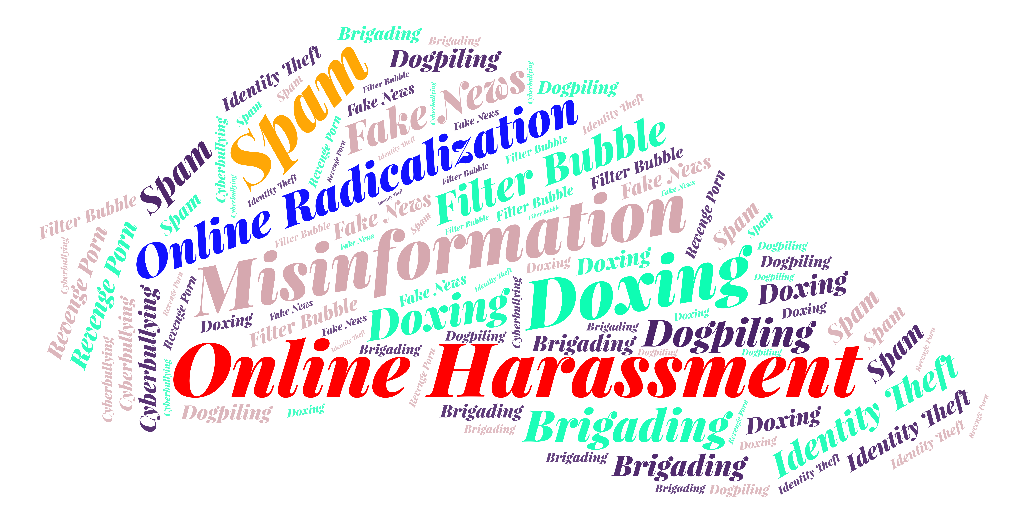
It addresses key problems on the internet
Notes:
Content moderation is responsible for addressing many of the key problems that social media platforms face today.

Slide 20
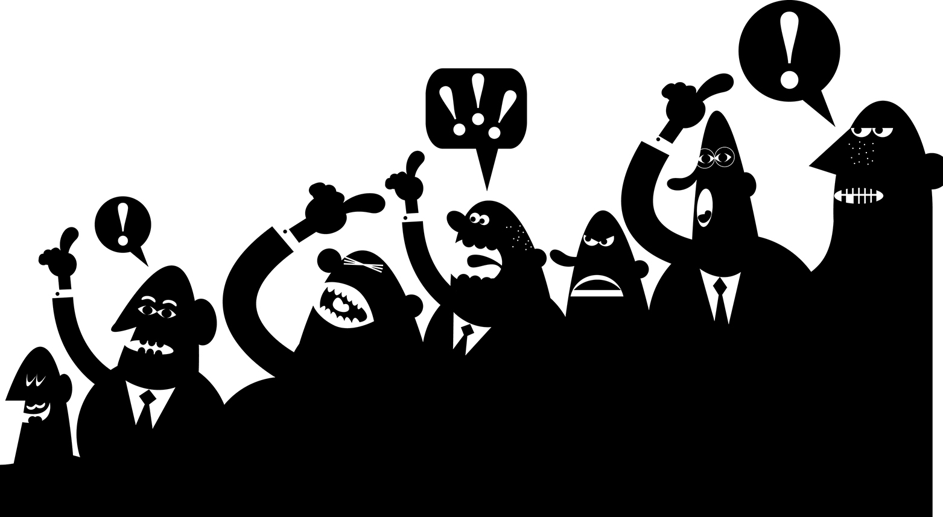
It shapes who gets heard
Notes:
At the same time, content moderation is critical to determining which groups’ voices get heard, and whether minorities and other vulnerable groups feel comfortable participating online.

Slide 21
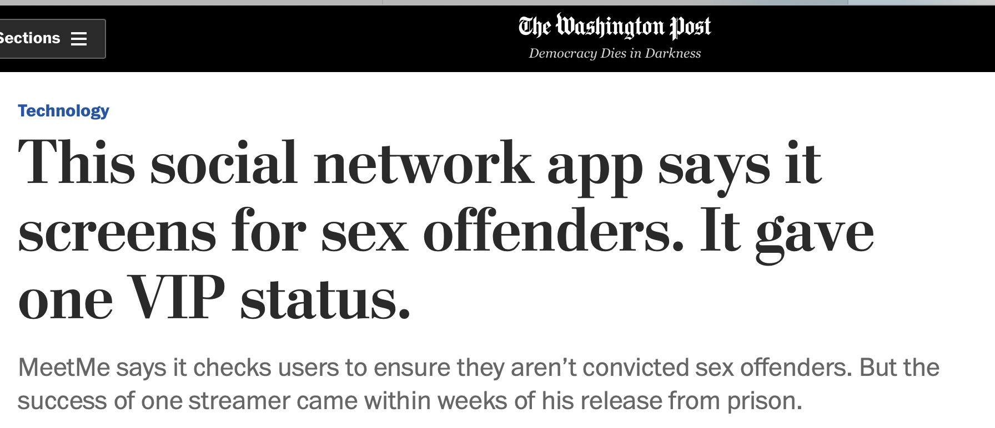
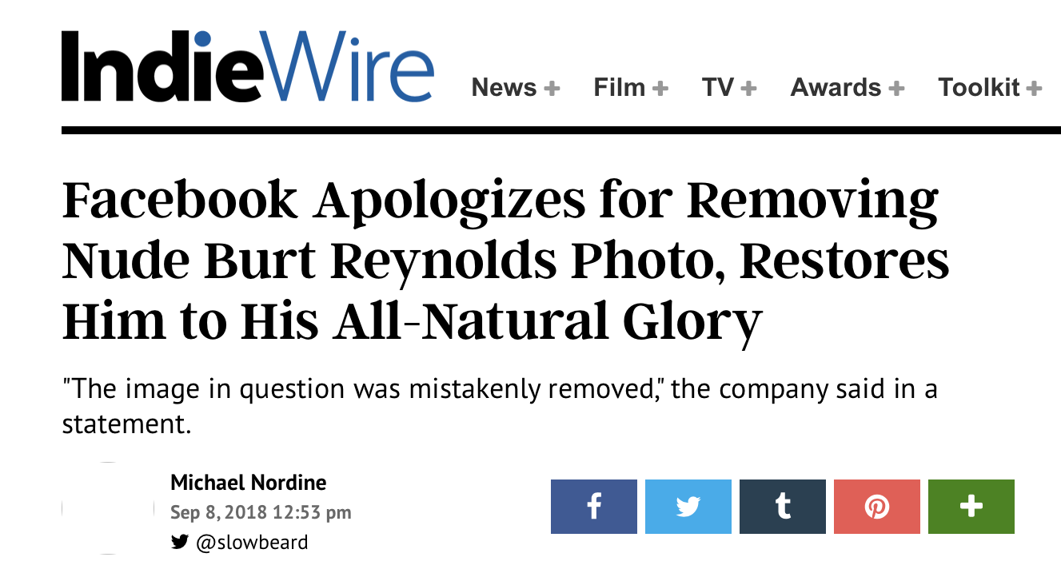
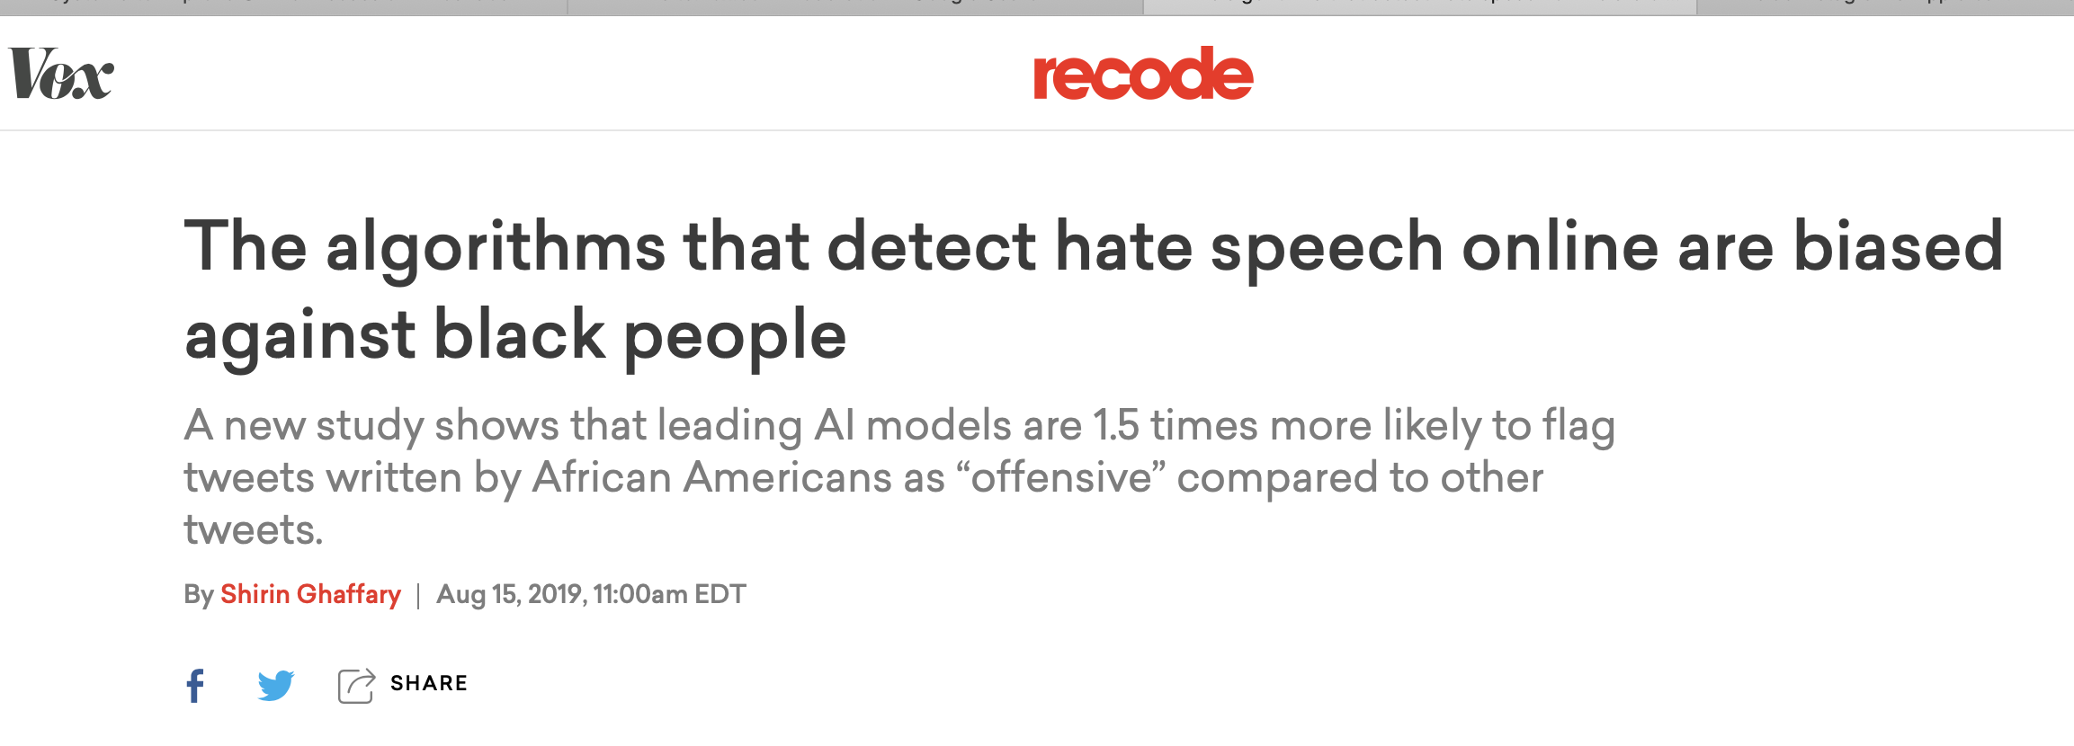
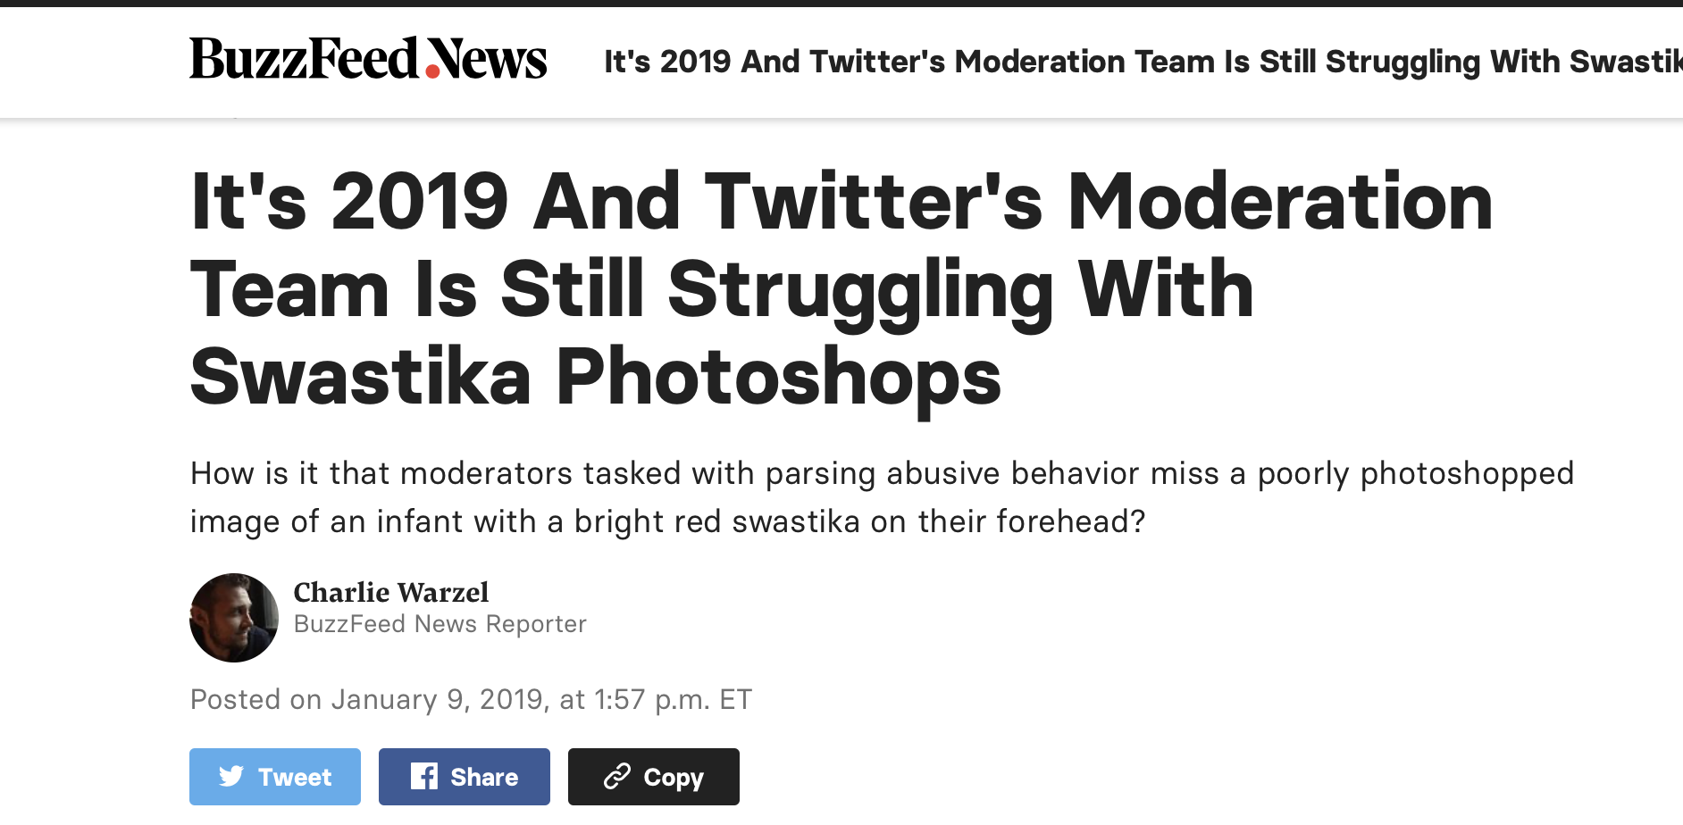
Content moderation is broken
Urgent need to address these failures

Slide 22
How can we improve content moderation?
Studying moderation apparatus
Understanding deficiencies
Designing new solutions
Notes:
In my research, I argue that we can improve content moderation by studying how the current moderation apparatus are built and attending closely to where and why they fail to address the needs of end-users. By doing this, we can gain insights into the deficiencies of current content moderation system. And once we understand these deficiencies, we can also inform the design of new solutions that may address these deficiencies and encourage more prosocial outcomes.

Slide 23
Keeping platforms accountable
“As more and more of our public discourse, cultural production, and social interactions move online, and [this] handful of massive, privately owned digital intermediaries continues to grow in economic and cultural power, it is crucial that we examine the choices moderators make” (Gillespie 2018).
Gillespie, Tarleton. Custodians of the Internet: Platforms, content moderation, and the hidden decisions that shape social media. Yale University Press, 2018.

Slide 24
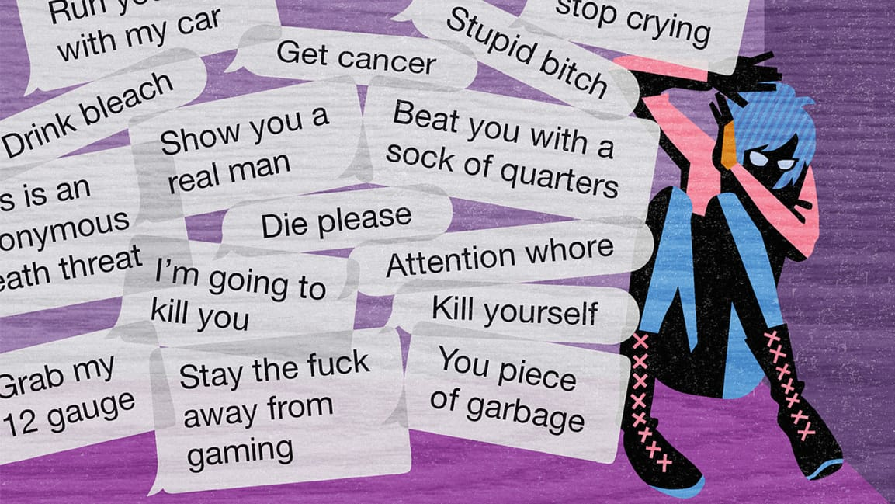



Approach: Study multiple stakeholders
Harassed users
Moderated users
Blockers
Moderators
Notes:
So now that we have established the importance of studying content moderation, let me explain how I do it.

Slide 25




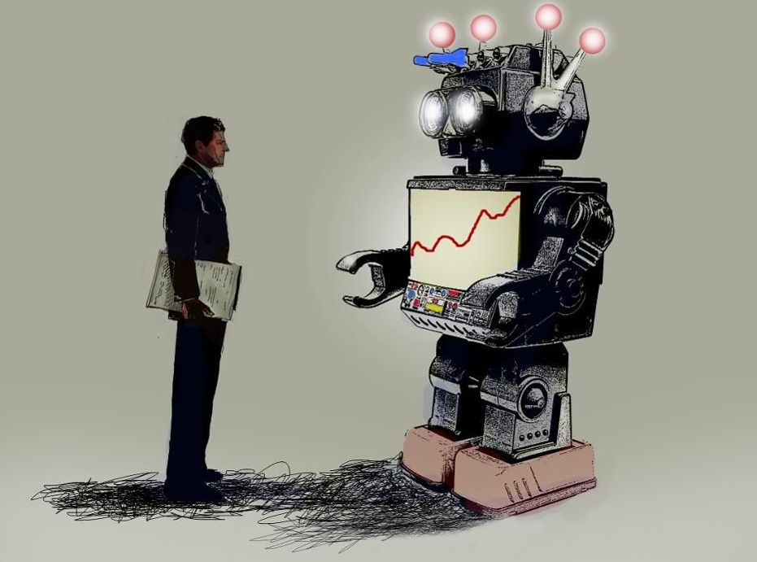
Online Harassment
Evaluating Moderation Interventions
Kotaku in Action
Twitter Blocklists
Quarantining
Deplatforming
Enacting Content Moderation
Enacting Content Moderation
Fairness and Transparency
Automod
Twitter Blocklists
User attitudes
after moderation
User behavior
after moderation

Slide 26
Admins
User group 1
Holistic view of content moderation
User group 2
Opportunities for improvements
…
Moderators
Moderation mechanisms
Notes:
– it is vital that we understand not just the perspectives of different user groups but also the conditions under which moderators work as well as the limitations of current moderation mechanisms.

Slide 27
Online Harassment
Evaluating Moderation Interventions
Kotaku in Action
Twitter Blocklists
Quarantining
Deplatforming
Enacting Content Moderation
Enacting Content Moderation
Fairness and Transparency
Automod
Twitter Blocklists
User attitudes
after moderation
User behavior
after moderation

Slide 28
Agenda
Research overview
Transparency in content moderation
Study 1: User attitudes
Study 2: User behaviors
Future work

Slide 29
Why is Transparency in Content Moderation Important?

Slide 30
Why is transparency important?
Platforms should respect human rights (Suzor et al. 2018*)
Freedom of expression
Due process
Due process is hurt by lack of transparency
Users cannot make sense of content takedowns
Difficult to seek remedy
* Nicolas Suzor, Tess Van Geelen, and Sarah Myers West. 2018. Evaluating the legitimacy of platform governance: A review of research and a shared research agenda. International Communication Gazette 80, 4 (2018), 385–400.
Notes:
There is a growing push by scholars and activists for platforms to have a responsibility to respect human rights. This includes freedom of expression. This also means that platforms should provide dur process for the users’ appeals against moderation decisions.
because when there is a lack of transparency, users cannot detect or make sense of content takedowns.
This makes it difficult for users to seek remedy for erroneous decisions

Slide 31
Why is transparency important?
Lack of transparency
Confuses users
Higher drop out rates
Source: West, S.M. (2018) Censored, Suspended, Shadowbanned: Researching User Experiences of Content Moderation on Social Media Platforms, New Media & Society.

Slide 32
Improving Transparency -> Explanations
Notes:
One strategy for improving transparency and retaining users' trust is to provide end users with explanations about why their content was removed.

Slide 33
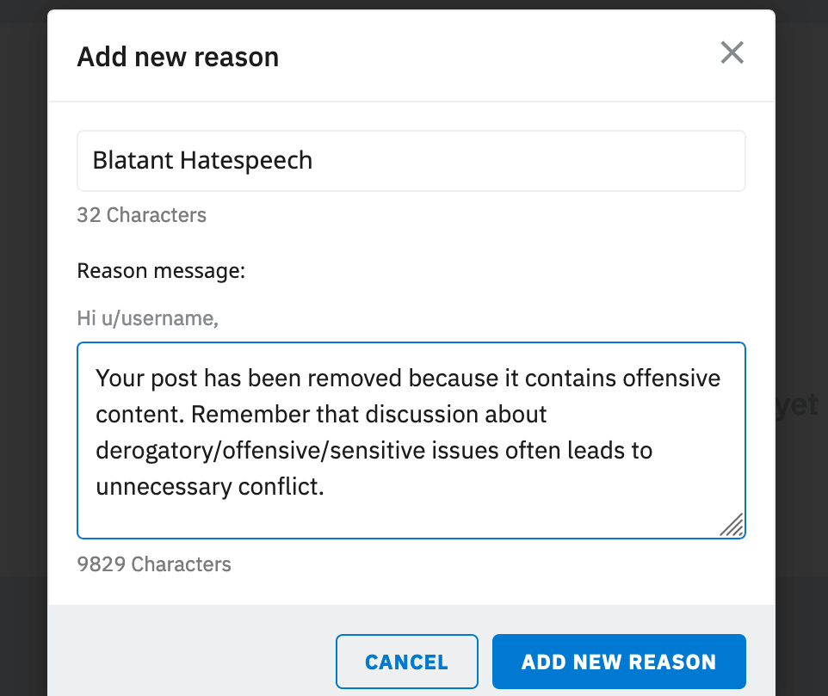
Potential role of explanations
Help users learn from mistakes
Cost
Curating explanations
Notes:
Such explanations can play an important role because they can help users
such as finding the right place to post a submission

Slide 34
Should moderators provide removal explanations?
Notes:
This brings up the question: Should moderators provide explanations?
And this is the central question I ask in this talk.
Is it worth it for moderators to spend their time and efforts into providing explanation for post removals?
Can such explanations improve user attitudes and behaviors?

Slide 35

Notes:
To answer this, I turned to the popular social media platform Reddit

Slide 36

Why Reddit?
1000’s of sub-communities
Variety of approaches to content moderation
Rich site to study how differences affect attitudes and behavior
Notes:
I chose Reddit because
Reddit is made up of thousands of communities, and these communities show a variety of approaches to enacting content moderation.
Therefore, the Reddit platform provides a rich site to study how the differences in moderation approaches affect the attitudes and behaviors of users differently.

Slide 37
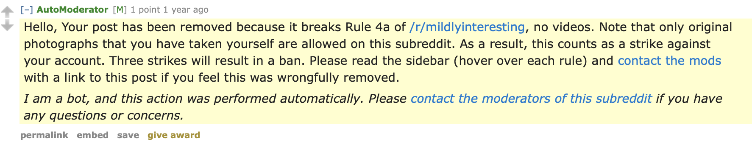
Explanation Comment Example
Notes:
This is what an explanation comment on Reddit looks like
This comment was posted as a reply to a submission that was removed.
and it provides user an explanation of exactly why their post was removed.
It warns the user that if they continue to violate rules, their account will be banned.
It also informs the user that if they believe that the removal is mistaken, they con contact the moderators of the subreddit.

Slide 38
Research questions
RQ 1: Attitudes
How is providing removal explanations associated with user attitudes?
RQ 2: Behaviors
How is providing removal explanations associated with future behaviors?
Survey
attitudes
Data mining
behaviors
Notes:
Given this context, I pose the following research questions.
My first question is about attitudes. I ask,

Slide 39

Why care about moderated users?
Not all moderated users are malicious
Crucial to have users who feel valued
Understanding concerns may help nurture valuable contributors
Notes:
Now the focus of these studies is on moderated users, but some people may ask, why should we care about moderated users? Some moderators consider them the scum of the earth. So why should we study them?
I argue that not all users are malicious. There are some users who get moderated just because they mistakenly violate a rule. In other cases, the moderation decision itself may be incorrect.
I also want to highlight that end-users are the central actors in online systems. They not only bring in the ad revenue that sustains these platforms but they are also the content creators. So it is crucial for platforms to have users who are invested in the online communities and who feel valued for their content contribution. This is why it is important for platforms to ensure that users feel they are moderated fairly.
concerns and experiences may also open up opporutnities for identifying and nurturing users who may become valuable contributors in the future.
Finally, From a wellness perspective, it is important to analyze the effects of content moderation on the levels of stress experienced by millions of end-users.

Slide 40
Agenda
Research overview
Transparency in content moderation
Study 1: User attitudes
Study 2: User behaviors
Future work

Slide 41

Study 1
RQ 1: Attitudes
How is providing removal explanations associated with user attitudes?
attitudes
“Did you Suspect the Post Would be Removed?”
Understanding User Reactions to Content Removals on Reddit
Shagun Jhaver, Darren Scott Appling, Eric Gilbert, Amy Bruckman
CSCW 2019

Slide 42
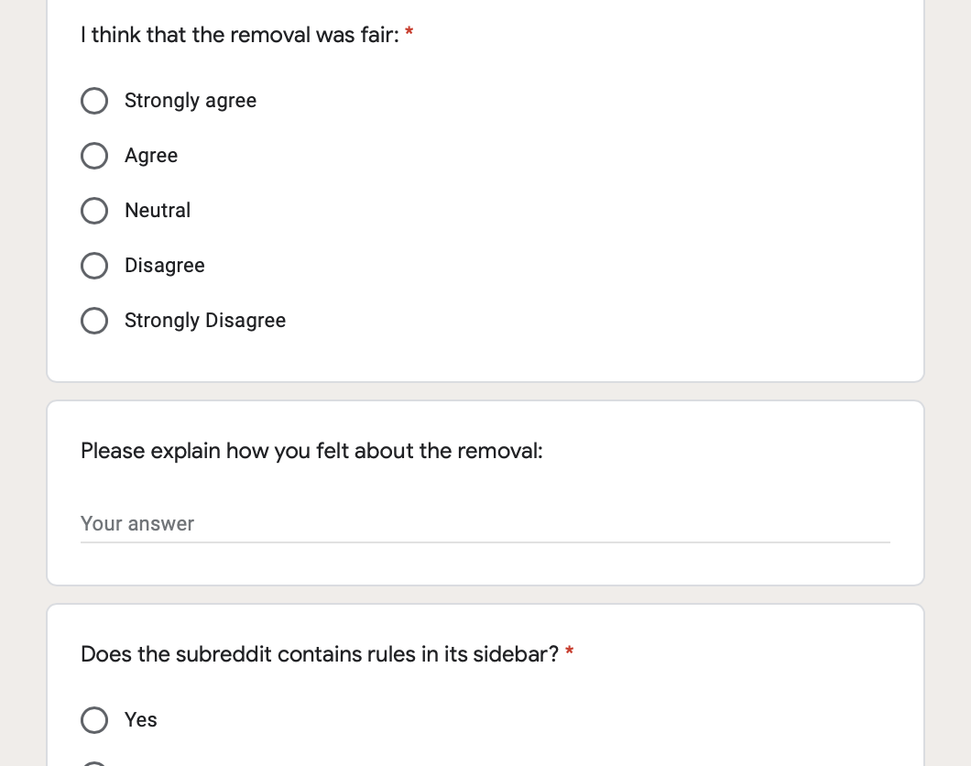
Survey
907 Reddit users who experienced content removals

Slide 43
Data collection goals
Submission should be recent
Enough time for moderators to review post
Survey request sent 3-10 hours
after post submission
Notes:
Enough time should have passed for moderators to review post

Slide 44
Sample recent Reddit posts
PRAW API
Posted within
past 12 hours?
Wait for
3 hours
If yes
…
Check removal status
Automated
data collection
If removed
Invite Poster to Participate

Slide 45
Survey questions
Multiple Choice Questions
Regression analyses
Open-ended Questions:
e.g., “Please explain how you feel about the post removal”
Inductive analysis

Slide 46
Quantitative Analysis
Notes:
Let me begin by discussing my quantitative analysis.

Slide 47
RQ 1: Attitudes
How is providing removal explanations associated with user attitudes?
attitudes
Fairness
Posting Again
Perceptions of fairness of post removal
Likelihood of posting again in the future
Q - I think that the removal was fair:
Strongly Agree
Agree
Neutral
Disagree
Strongly Disagree
Q – How likely are you to post again on this subreddit after this experience? :
Very likely
Likely
Neutral
Not likely
Very unlikely
Notes:
I focused on two aspects of user attitudes
that I will refer to as Fairness
I derived information about users' perceptions of fairness through answers to the survey questions

Slide 48
RQ 1: Attitudes
How is providing removal explanations associated with user attitudes?
attitudes
Fairness
Posting Again
Perceptions of fairness of post removal
Likelihood of posting again in the future
Dependent Variables
Linear Regression
Notes:
I developed linear regression models to analyze the relationship between different variables, and I used fairness and posting again as my dependent variables

Slide 49
Control variables
Demographics (collected through survey)
Age
Education
Gender
Prior History (collected using Reddit API)
Reddit karma (popularity metric)
Time on Reddit (in days)
Number of submissions posted on Reddit

Slide 50
Insights
Notes:
In the interest of time, I will only discuss a sample of insights we gained from our quantitative results, but please check out the paper for more insights.

Slide 51
Q1: Before you started this survey, did you know that your post was removed?:
Yes
No
Notes:
I want to note here whether or not users are aware of their post removal is an important aspect of transparency in content moderation.
Surprisingly, I found that
In fact, I received dozens of replies to my invitation messages where users expressed surprise about their post removals.

Slide 52
Awareness of post removal
Fairness
(β = 0.265***)
Posting Again
(Not significant)
❌
***: p < .001
Notes:
My regression analyses show that when users become aware of their post removals, perhaps through communication by the moderation team, they are more likely to consider the moderation of their post as fair than when they are not made aware.
Noticing removals, however, did not have any statistically significant effect on whether participants consider it likely they will post in the future.

Slide 53
Users care about being
notified of post removals

Slide 54
Q2: Did you receive an explanation for why your post was removed?:
39.7%
Yes
No
60.3%

Slide 55
Receiving explanation
Fairness
(β = 0.384***)
Posting Again
(β = 0.088*)
*: p < .05 ***: p < .001
Notes:
My regression analyses show that when users become aware of their post removals, perhaps through communication by the moderation team, they are more likely to consider the moderation of their post as fair than when they are not made aware.
Noticing removals, however, did not have any statistically significant effect on whether participants consider it likely they will post in the future.

Slide 56
Receiving explanations is linked to
improvement in user attitudes

Slide 57
Q3: Did the explanation provide you information you didn’t know before?:
64.2%
Yes
No
35.8%

Slide 58
New Information in explanations
Fairness
(β = 0.200***)
Posting Again
(Not significant)
❌
***: p < .001
Notes:
My regression analyses show that when users become aware of their post removals, perhaps through communication by the moderation team, they are more likely to consider the moderation of their post as fair than when they are not made aware.
Noticing removals, however, did not have any statistically significant effect on whether participants consider it likely they will post in the future.

Slide 59
The content of explanation matters

Slide 60
Q4: The explanation was provided by:
Unsure
29.4%
50.6%
Bot
Human
20%

Slide 61
Explanation source
Fairness
(Not significant)
Posting Again
(Not significant)
❌
❌
Notes:
My regression analyses show that when users become aware of their post removals, perhaps through communication by the moderation team, they are more likely to consider the moderation of their post as fair than when they are not made aware.
Noticing removals, however, did not have any statistically significant effect on whether participants consider it likely they will post in the future.

Slide 62
Humans don’t have an advantage over bots
in improving user attitudes

Slide 63
Qualitative Findings
Notes:
Next, I will discuss our qualitative findings, which resulted from my inductive analysis of open-ended responses in the survey.
These results add support and nuances to the findings that I have presented so far.

Slide 64
Frustration about the post removals
“
I am autistic, and it takes significant effort for me to write up things to communicate effectively and in a way that will be received well. I feel sad that my effort in making that post was for nothing and that no one will see it, and no one will reply with any help or advice.
- Poster on r/disability sub
”
Notes:
This shows how content takedowns can have a deeply negative affect on some vulnerable end-users.

Slide 65
Dissatisfaction about the lack of transparency
“
The removal is ok, it doesn’t bother me, but it’s not ok that I didn’t get informed. – P838
”

Slide 66
Some users self-identify as trolls
Deliberately violate rules
Receiving removal explanations does not matter
Notes:
Our analyses indicate that some user identify themselves as trolls.
Although these users are aware of the community rules, they deliberately violate those rules.
For example, one of our participants who hated the Patriots football team wrote
This indicates that it may not be worth moderators’ efforts to provide explanations to users who are trolls

Slide 67
Some users self-identify as trolls
“
I will always post stupid things on the Patriots subreddit until they ban me because I hate the Patriots.
– P579
”
Notes:
Our analyses indicate that some user identify themselves as trolls.
Although these users are aware of the community rules, they deliberately violate those rules.
For example, one of our participants who hated the Patriots football team wrote
This indicates that it may be important to distinguish trolls from other users, and not waste moderation resources on trolls.

Slide 68
Acceptance of removal as appropriate
“
I felt bad that I had not read the rules and posted inappropriately.
– P736
”
Notes:
These are the types of users who we want to identify and nurture and turn into valuable contributors.

Slide 69
Study 1
Improvements in fairness perceptions
attitudes
Transparency =>
How is transparency associated with improvements in future behaviors?
behaviors

Slide 70
Agenda
Research overview
Transparency in content moderation
Study 1: User attitudes
Study 2: User behaviors
Future work

Slide 71

Study 2
RQ 2: Behaviors
How is providing removal explanations associated with future behaviors?
behaviors
“Does Transparency in Moderation Really Matter?”
User Behavior after Content Removal Explanations on Reddit
Shagun Jhaver, Amy Bruckman , Eric Gilbert
CSCW 2019

Slide 72
Data Preparation
Notes:
Let me start by discussing how I prepared data for this study

Slide 73
Reddit Corpus
Mar – Oct 2018
80M posts
<user, subreddit> Pairs
4.7M pairs
subsample
For each pair
H(user, subreddit)
Post History
Mar – Oct 2018

Slide 74
RQ 2: Behaviors
How is providing removal explanations associated with user behavior?
behaviors
H(user, subreddit)
Post History
Mar – Oct 2018
Splitting Post History
Past Posts
Future Posts
H(user, subreddit)_{past}
Mar – June 2018
H(user, subreddit)_{future}
July – Oct 2018
Independent Variables
Dependent Variables

Slide 75
RQ 2: Behaviors
How is providing removal explanations associated with user behavior?
behaviors
Future Removal (u, s)
Does user u have a future post in subreddit s that is removed?
Dependent Variable
Logistic Regression
Notes:
I focused on one specific aspect of user behavior.
I tracked for each <u, s> pair, whether the user u has a future submission in subreddit s that is removed, and I call this variable Future Removal. Now this is a binary variable, so I built logistic regression models to analyze the relationships between different independent variables and Future Removal, which I considered to be my DV.

Slide 76
Control variables
Subreddit Variables
# Subreddit Subscribers
# Subreddit Submissions
Net Subreddit Removal Rate
Post History Variables
Past Submissions by user u in subreddit s
Avg. Past Score
Avg. Past Comments
Notes:
These variables are indicative of the size, activity level, and moderation rate of each Reddit community. I control for these variables because I suspected that they are likely to have an effect on user activity.

Slide 77
Data
32 Million Submissions
Extracted removal explanations for removed posts:
213K explanation messages

Slide 78
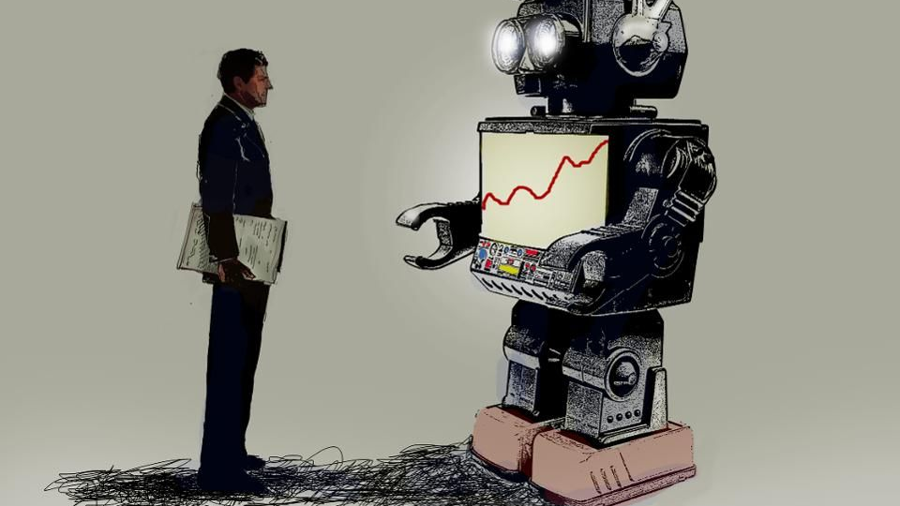
Who provides explanations?
Human
Moderators
Bots
42%
58%
Notes:
I analyzed how frequently removal explanations are provided by bots as compared to human mods, and I found that

Slide 79
Reporting the results
Odds ratios percentage
Percentage change in the odds of DV when an IV is increased by one SD

Slide 80
Findings: Regression Analysis

Slide 81
IV: Explanation rate
Proportion of removed posts that received explanations
Explanation rate
Future Removals
(6.5% lower odds***)
Nagelkerke R Square = 0.187
***: p < .001

Slide 82
Explanations are linked to
improved behaviors

Slide 83
IV: Explanation by bot rate
Proportion of explanations that are provided by bots
Explanation by
bot rate
Future Removals
(Not significant)
❌
Nagelkerke R Square = 0.231

Slide 84
Humans don’t have an advantage over bots
in improving user behaviors

Slide 85
Contributions: Transparency in content moderation
Study 1
Improvements in fairness perceptions
Transparency =>
attitudes
Study 2
behaviors
Improvements in
user behaviors
Transparency =>

Slide 86
Takeaways

Slide 87

Transparency of moderation
Transparency is a key concern
Users care about being notified of post removals
Users care about receiving explanations for post removals
Transparency may reduce moderator workload
Moderation should play an educational role

Slide 88
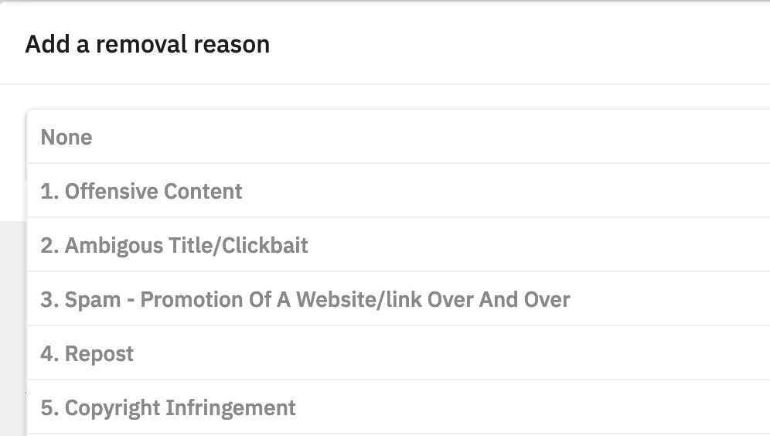
Removal explanations help users learn social norms
Direct feedback
Which rule is broken
Public posting
New, relevant information is better
Notes:
In addition to the analyses I have shown in this talk, I also analyzed the content of removal explanations through topic modeling and through manual review of dozens of explanations.
One interesting feature of removal explanation is that they are often publicly posted, so bystanders who are already engaging with the post can see why the post was removed, and learn from others’ mistakes.
Finally, how these explanations are designed matter. For example, my survey analyses show that new information or information that is more relevant to the context of the post is associated with further improvements in user attitudes.

Slide 89

Who should provide explanations? Humans or bots
Human mods have no advantage over bots:
for improving user attitudes
for improving user behavior
Opportunity for deploying tools for explanations
Explainable AI
Notes:
Before I started this project, I had hypothesized that users would react to explanations provided by humans differently than explanations provided by bots

Slide 90
Removal Explanations
attitudes
behaviors
Example of
Mixed-methods Analyses
z
Insights into social needs
Improve behaviors
Notes:
So in this talk, I have focused just one design choice, the provision of removal explanations, and discussed how it relates to user attitudes and behaviors. But this provides a concrete example of how my mixed-methods analysis approach can help us obtain nuanced insights into
And going forward, I hope to continue using such mixed-methods approaches to inform the design of other moderation strategies in online communities.

Slide 91
Agenda
Research overview
Transparency in content moderation
Study 1: User attitudes
Study 2: User behaviors
Future work

Slide 92
Improving Content Moderation
Notes:
Content moderation is a rich, complex, multi-layered practice, and there are lots of open questions in this area that I am interested in but let me highlight three directions that I am particularly excited about.

Slide 93
Incentivizing compliance with community norms
Psychological and economic incentives
Graduated sanctions (Ostrom 1991)
Punishment in proportion to offense
Different user groups need different incentives/sanctions
How do moderators decide which strategy to use?
Surveys and interviews with:
Moderators
Users
Policy recommendations and tools
Test using data-driven evaluation
Ostrom, Elinor. Governing the commons: The evolution of institutions for collective action. Cambridge university press, 1990.
Notes:
I am interested in understanding how we can encourage users’ compliance with online community norms through psychological and economic incentives.
For example, I want to explore the idea of using graduated sanctions. This idea is inspired by Ostrom’s studies of successful institutions for governing common pool resources. Ostrom argues that when offenders are punished in proportion to their crimes, they are more likely to learn from their mistakes, and improve their behavior in the future.
I believe this idea can be applied in the context of online communities, because in my interviews with moderators, they have often told me that different user groups need different incentives/sanctions. For example, some moderators have pointed out to me that they have found situations in which a temporary ban is much more powerful than a permanent ban because when users are permanently banned, they just create a new account, and start posting bad content again.
And I want to understand more of these folk theories of moderators. I will conduct surveys and interviews with moderators to understand how they decide which sanctions to use under what circumstances. I will also interview moderated users to understand how they perceive different incentives and sanctions.
This line of work will generate policy recommendations for moderators to use different incentives and sanctions in different situations. I will also explore how we can create tools that help moderators execute these recommendations.
I will also test the effectiveness of these recommendations using data-driven evaluation.

Slide 94
Effects of moderation on other platforms
Current work: Community-wide moderation interventions on Reddit
Migration patterns after a toxic community is moderated
Where do users migrate to and why?:
Qualitative analysis of community posts
Interviews with members from banned communities
Interrupted time-series analysis for similar communities on other platforms
Effects of migration on radicalization:
Activity levels
Toxicity levels
How can platforms work together?
Notes:
What factors contribute to the increase in these figures… ?
Through this work, I want to explore how platforms can design their moderation strategies to avoid this spread of toxicity to other platforms and how platforms can work together in order to anticipate such migrations, and prepare for them.

Slide 95
Effects of algorithmic curation on content creators
Prior work: Airbnb search algorithm
How does algorithmic curation affect content creators?
Amazon.com, YouTube, Yelp, Dating sites
Method: Surveys and Interviews with content creators
What information do platforms provide? How do users attend to this information?
What information sources do creators rely on?
How are content creators’ attitudes and practices affected by:
Belief in the competency of algorithms
Belief in the consistency of algorithms
Notes:
Moving beyond transparency
This research will inform how platforms should develop their content curation processes and how they should communicate to their users about these algorithms

Slide 96
Thank you!
Advisors: Amy Bruckman, Eric Gilbert
Mentors: Neha Kumar, Scott Counts, Judd Antin
Collaborators: Justin Cranshaw, Jacob Eisenstein, Munmun De Choudhury, Latifur Khan, Cliff Lampe, Eshwar Chandrasekharan, Sucheta Ghoshal, Scott Appling, Benjamin Sugar, Yoni Karpfen
Mentees: Maya Holikatti, Iris Birman, Christian Boylston, Kevin Tang, Pranil Vora
Notes:
And I would like to conclude by thanking my advisors Amy Bruckman and Eric Gilbert, and the amazing researchers that I have been fortunate to collaborate with and the students that I have been able to mentor

Slide 97


Toward Fairness and Transparency in Content Moderation
www.shagunjhaver.com
@shagunjhaver
Shagun Jhaver

Slide 99
Bonus Slides

Slide 100
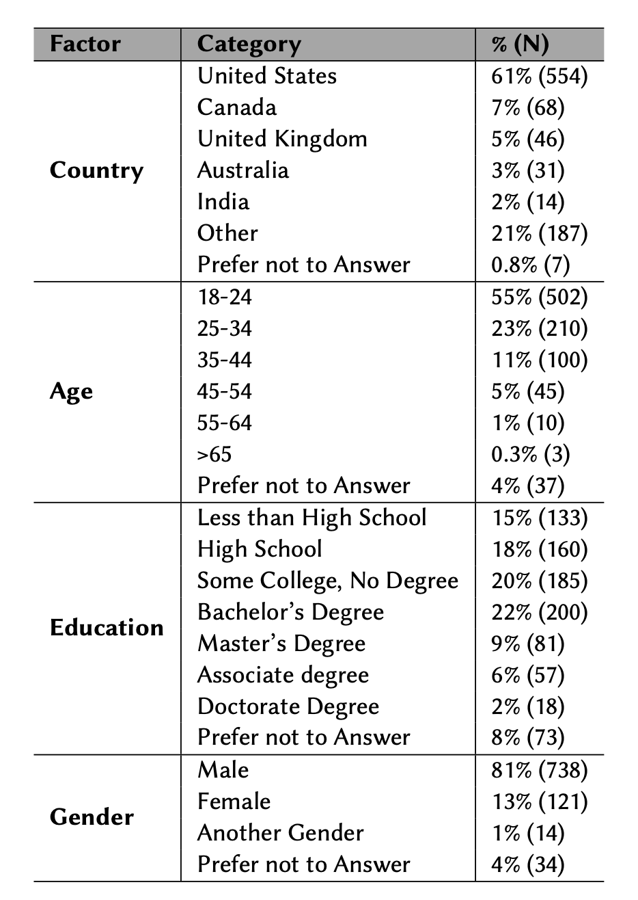

Slide 101
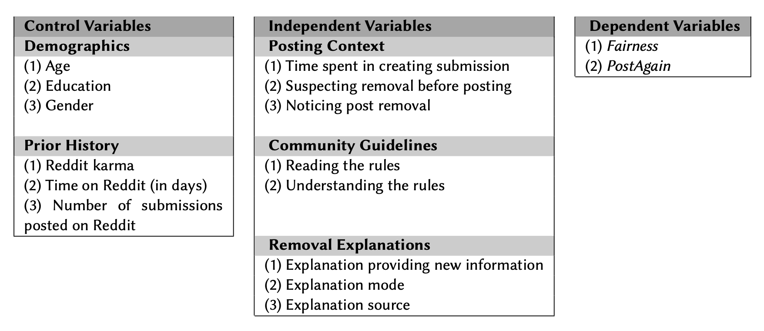

Slide 102
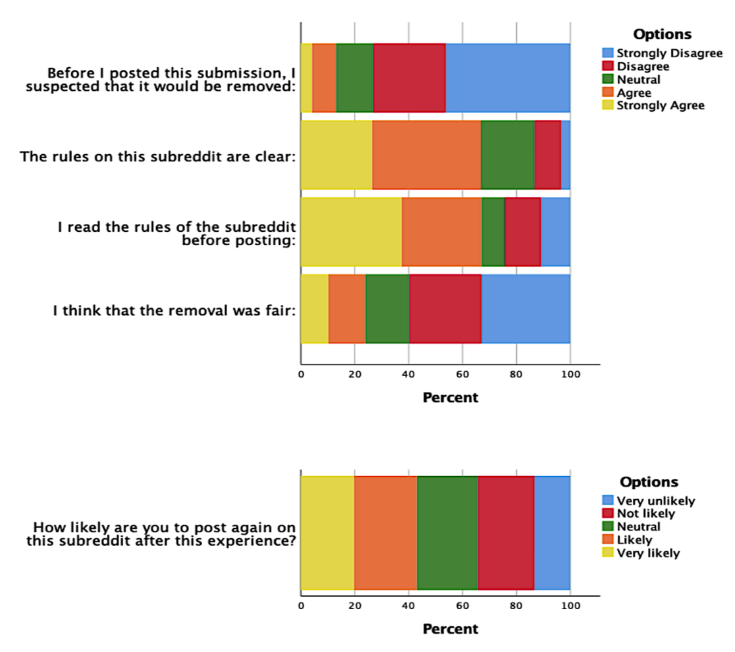

Slide 103
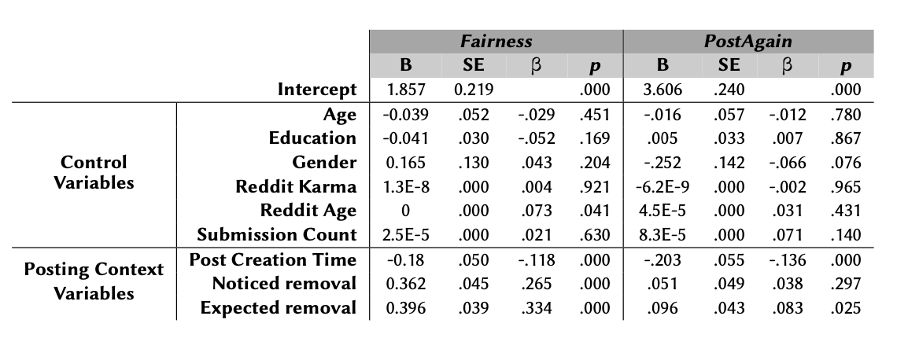

Slide 104
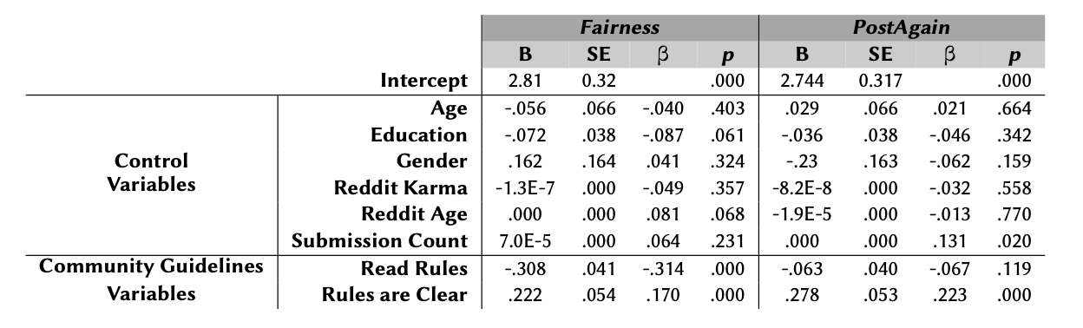

Slide 105
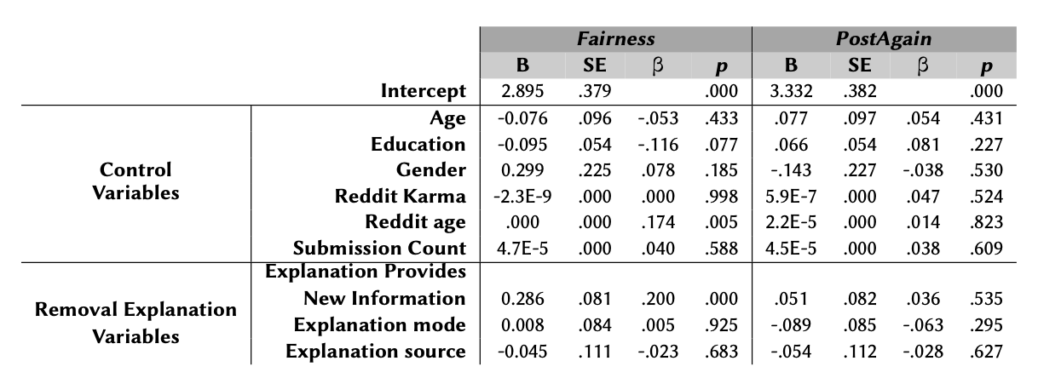

Slide 106
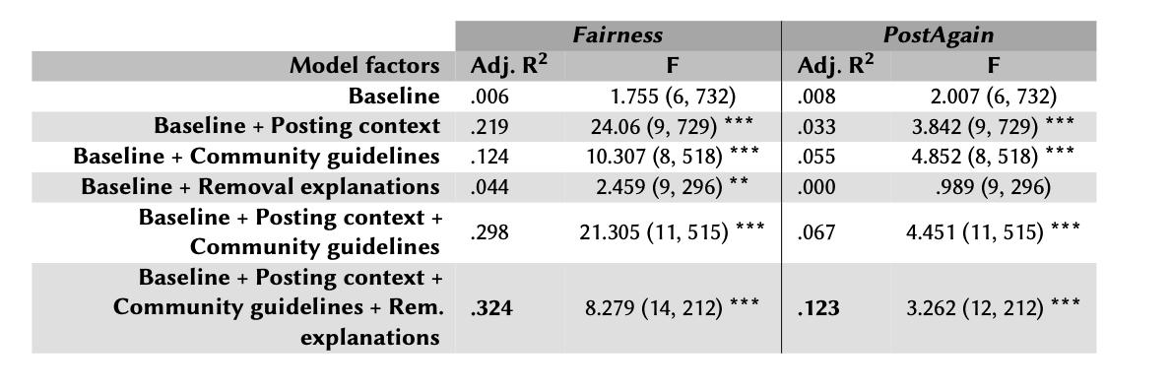

Slide 107
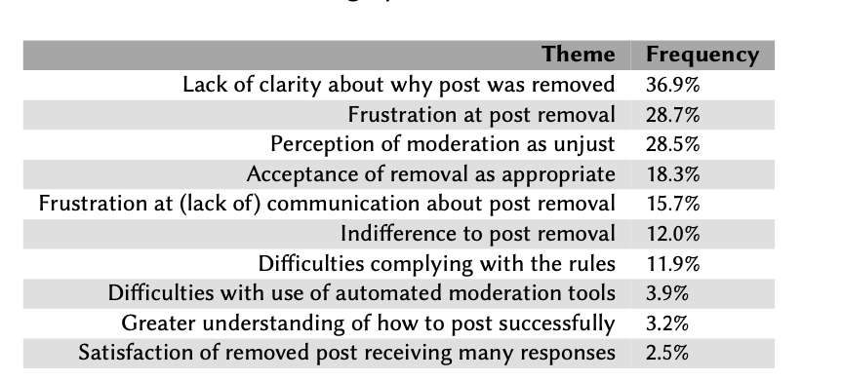

Slide 108
Explanations Paper

Slide 109
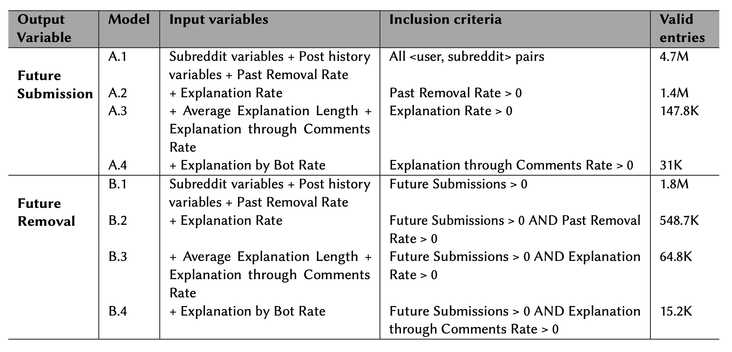
Notes:
I developed a series of regression models to test the effects of different aspects of removal explanations.
One of the values of this work is that we developed these models very carefully and we meticulously described many of the assumptions and simplifications we made in our modeling.

Slide 110
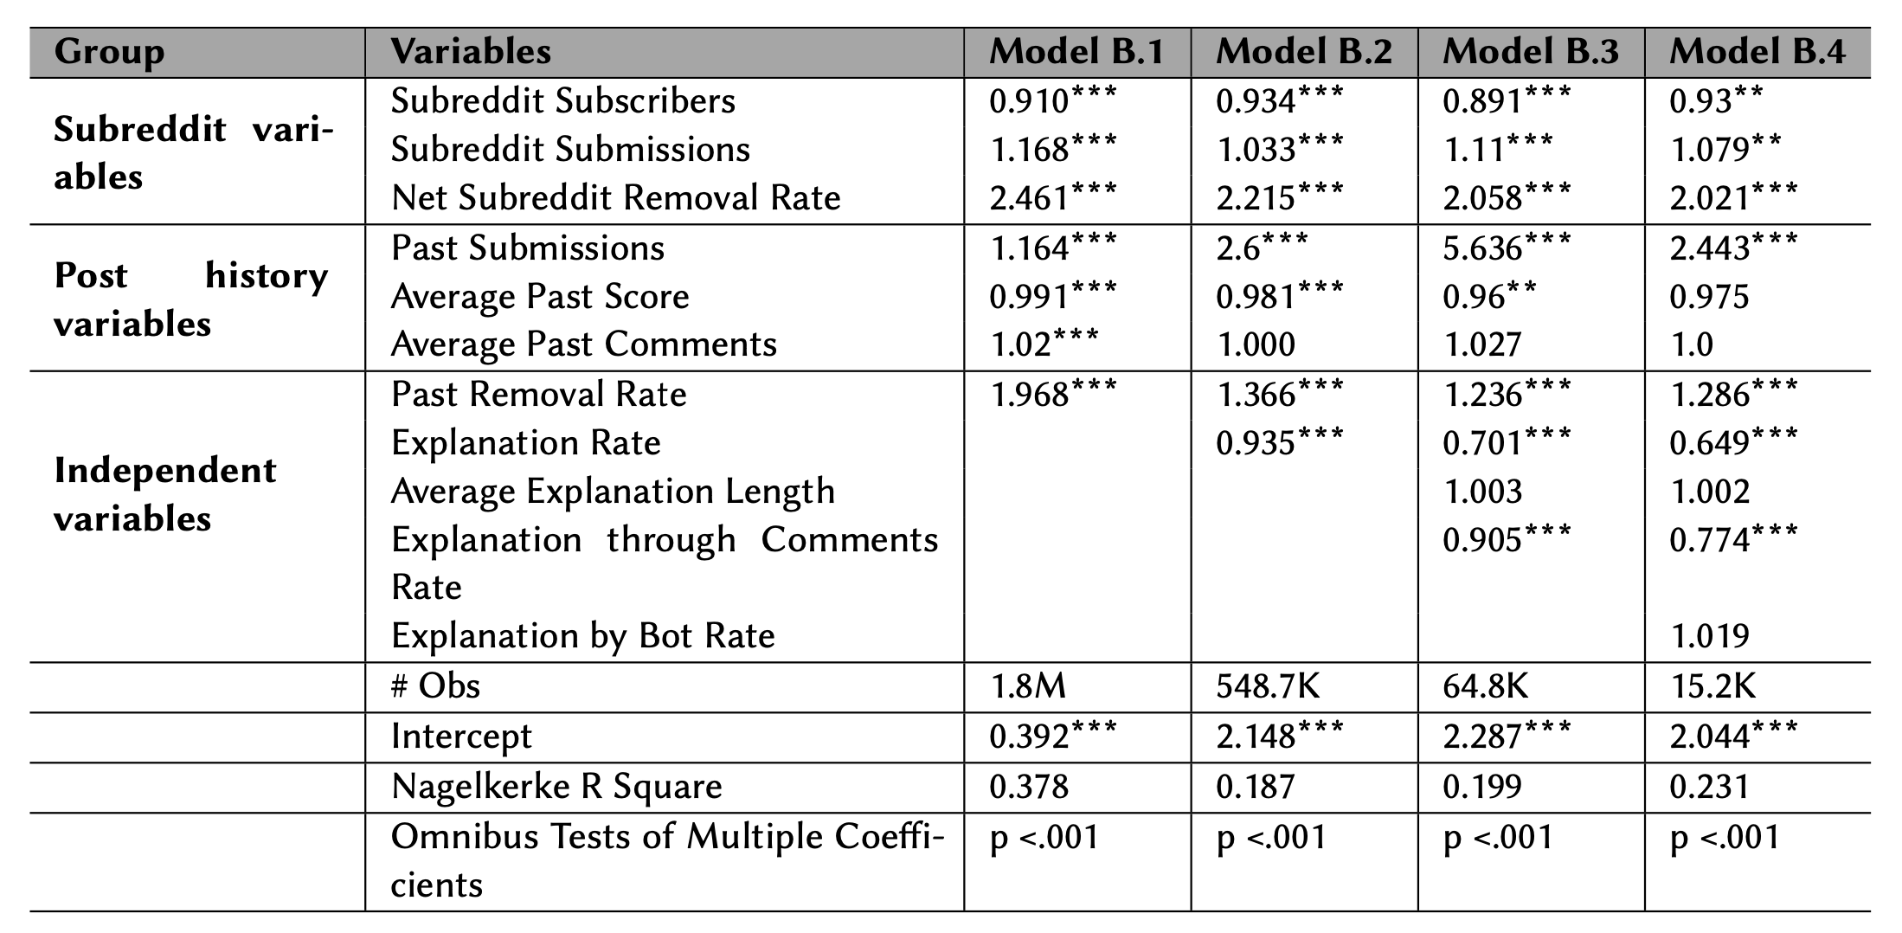
Regression Results – Future Removals

Slide 111
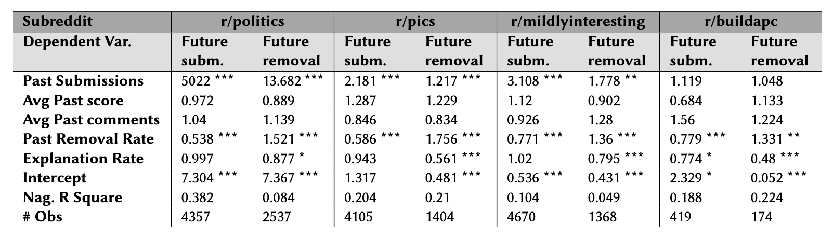
Subreddit Models

Slide 112
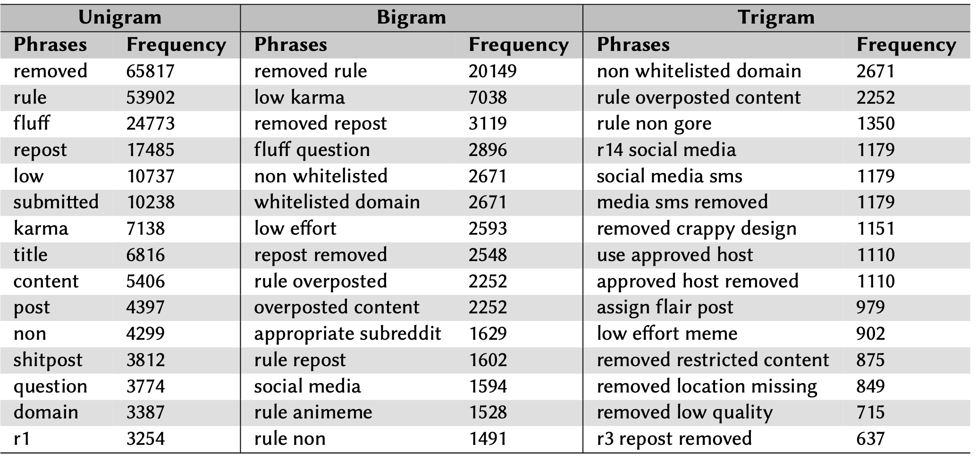
Explanation Flairs

Slide 113
Preparing Survey Questionnaire
Questions based on tension points around content moderation in prior research.
Cognitive pre-tests.
Pilot tests.

Slide 114
Subreddits I have moderated
Youtubers
Justiceserved
Bibliographies
Science
Onejob

Slide 115
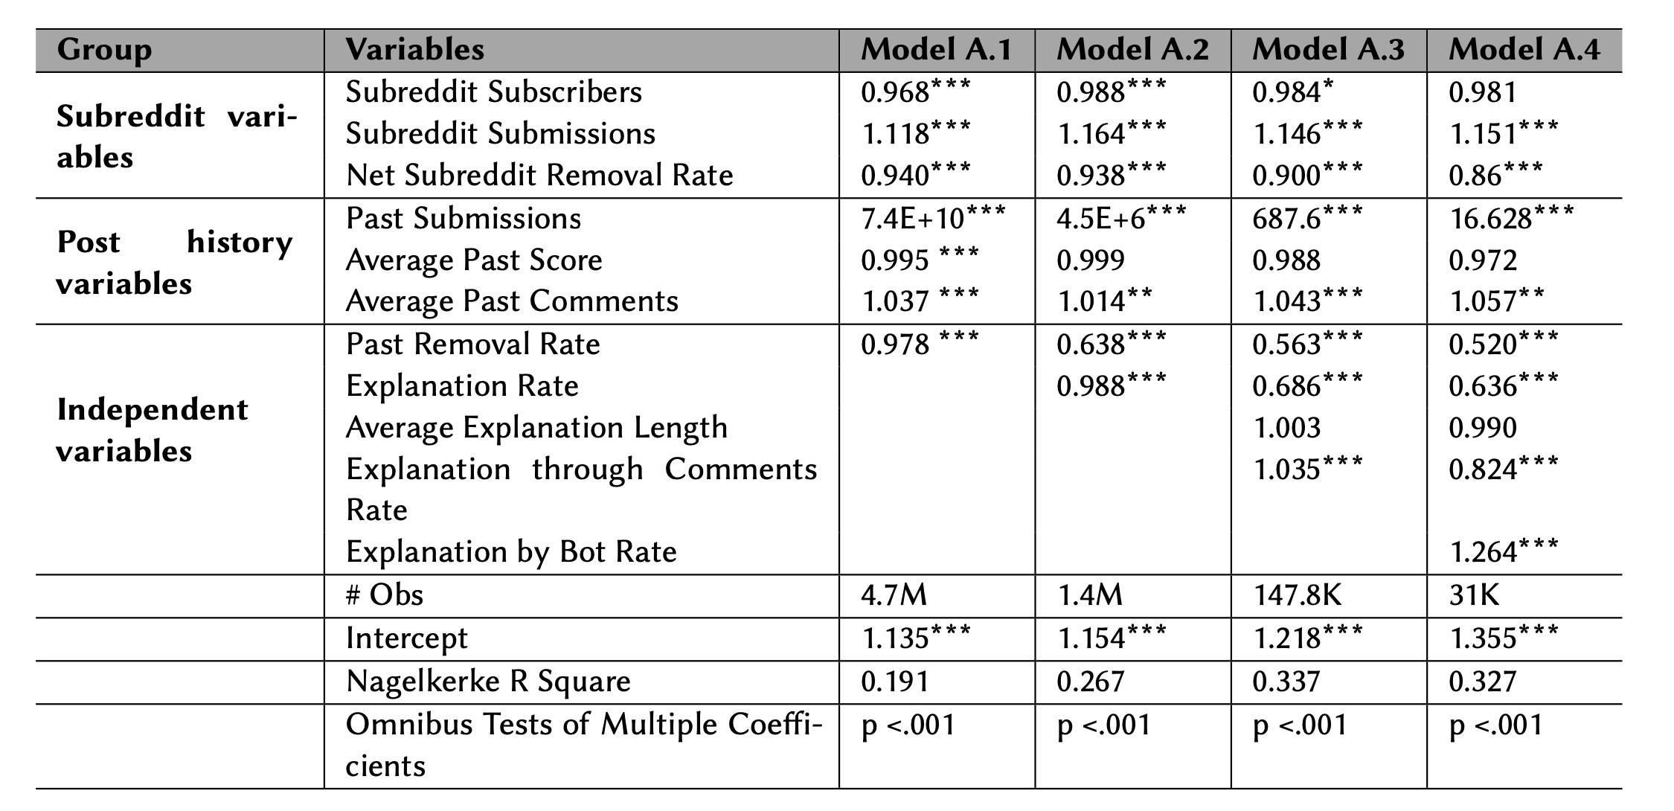
Regression Results – Future Submissions

Slide 116
Reporting the results
Odds ratios percentage
Percentage change in the odds of DV when an IV is increased by one SD

Slide 117
Focus on Reddit submissions
Notes:
in my observations and in my interviews with Reddit moderators, I have found that Reddit comments are very rarely p

